Slide 1

Chapter 13 – part I

Slide 2
OUTLINE
  Law of gravitation.
  Gravitational potential energy.
  Motion of satelites.

Slide 3
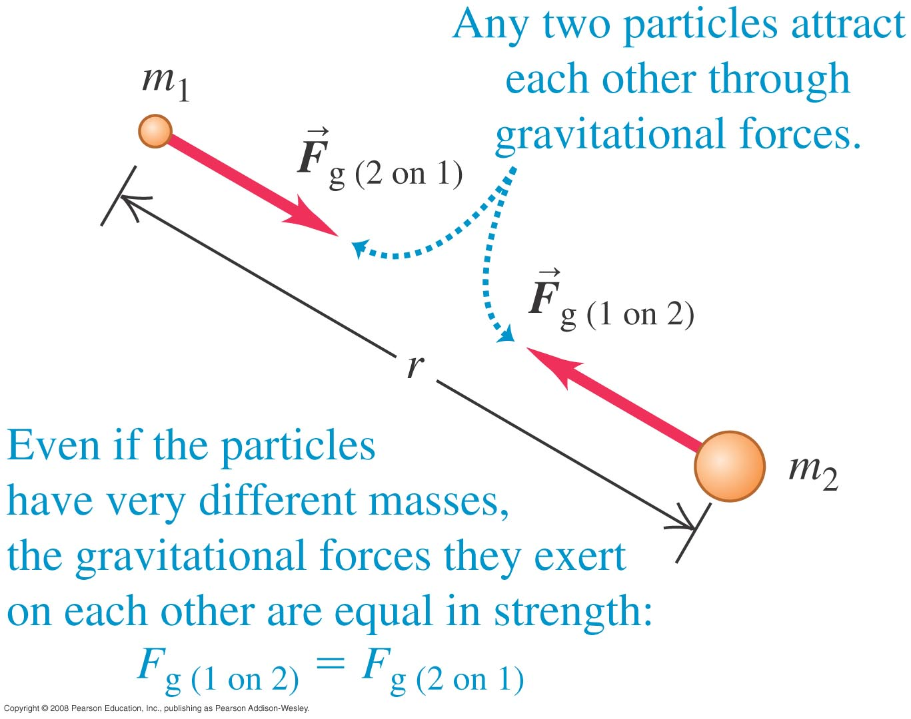
Newton’s law of gravitation
Law of gravitation: Every particle of matter attracts every other particle with a force that is directly proportional to the product of their masses and inversely proportional to the square of the distance between them.
The gravitational force can be expressed mathematically as F_{g} = Gm₁m₂/r², where G is the gravitational constant.

Slide 4
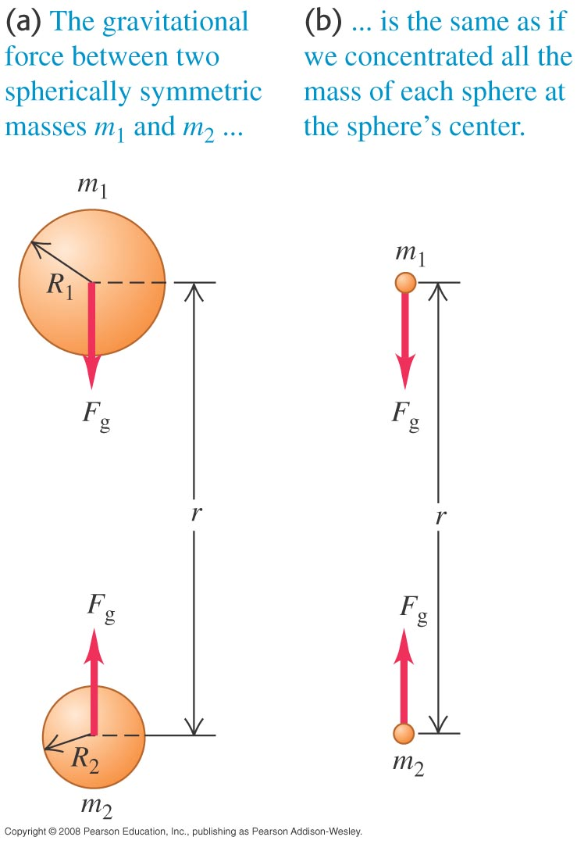
Gravitation and spherically symmetric bodies
The gravitational interaction of bodies having spherically symmetric mass distributions is the same as if all their mass were concentrated at their centers.

Slide 5
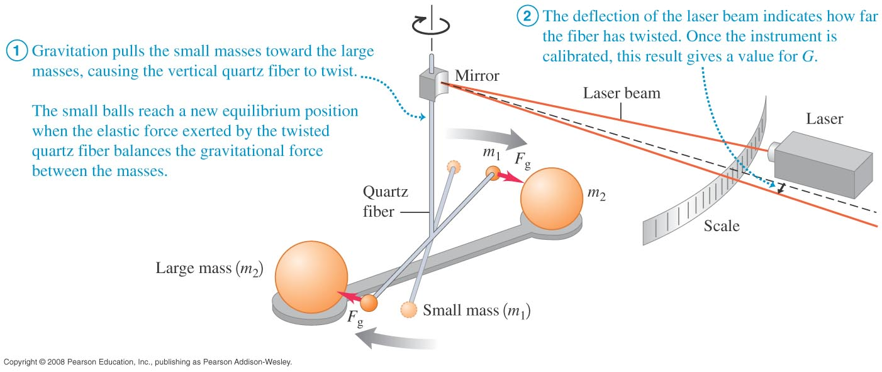
Determining the value of G
In 1798 Henry Cavendish made the first measurement of the value of G.

Slide 6
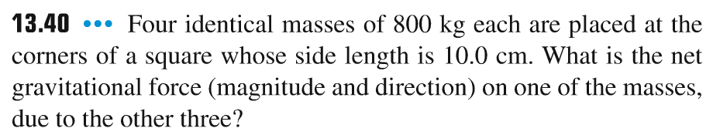
Problem #1

Slide 7
Weight
The weight of a body is the total gravitational force exerted on it by all other bodies in the universe.
At the surface of the earth, we can neglect all other gravitational forces, so a body’s weight is w = Gm_{E}m/R_{E}².
The acceleration due to gravity at the earth’s surface is g = Gm_{E}/R_{E}².

Slide 8
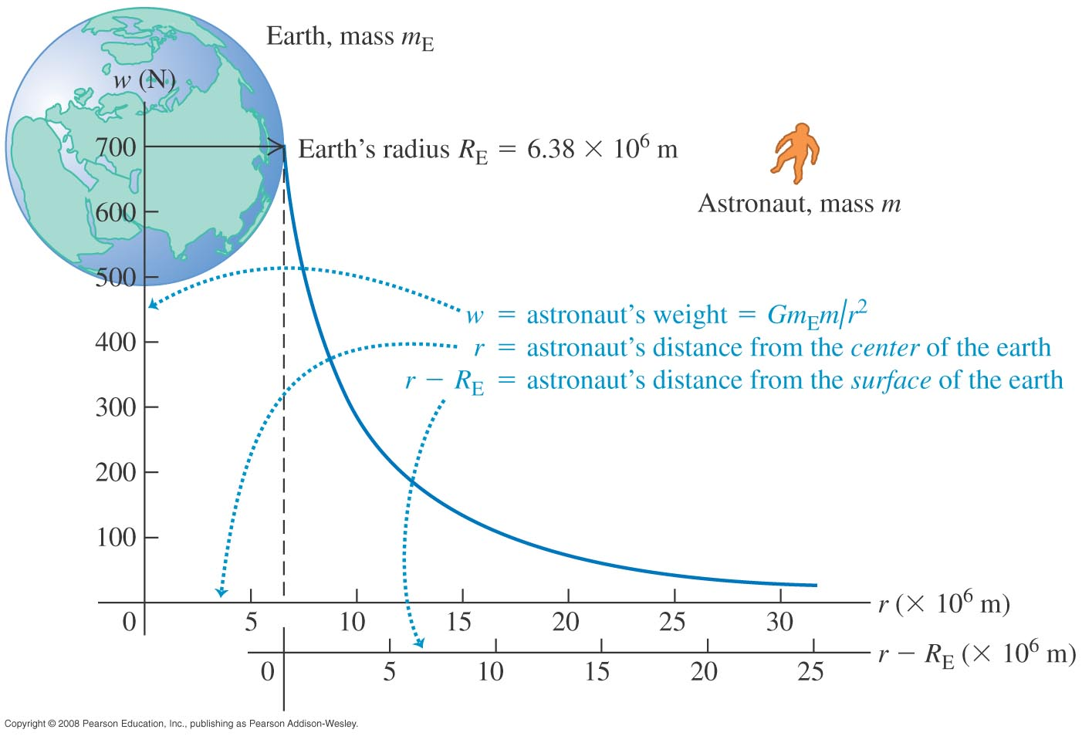
Weight
The weight of a body decreases with its distance from the earth’s center.

Slide 9
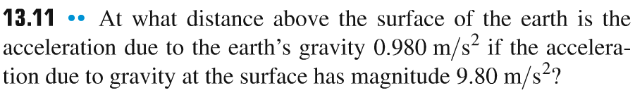
Problem #2

Slide 10
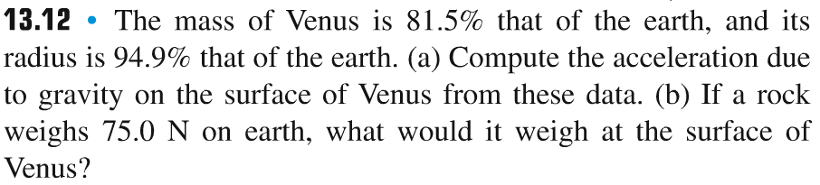
Problem #3

Slide 11
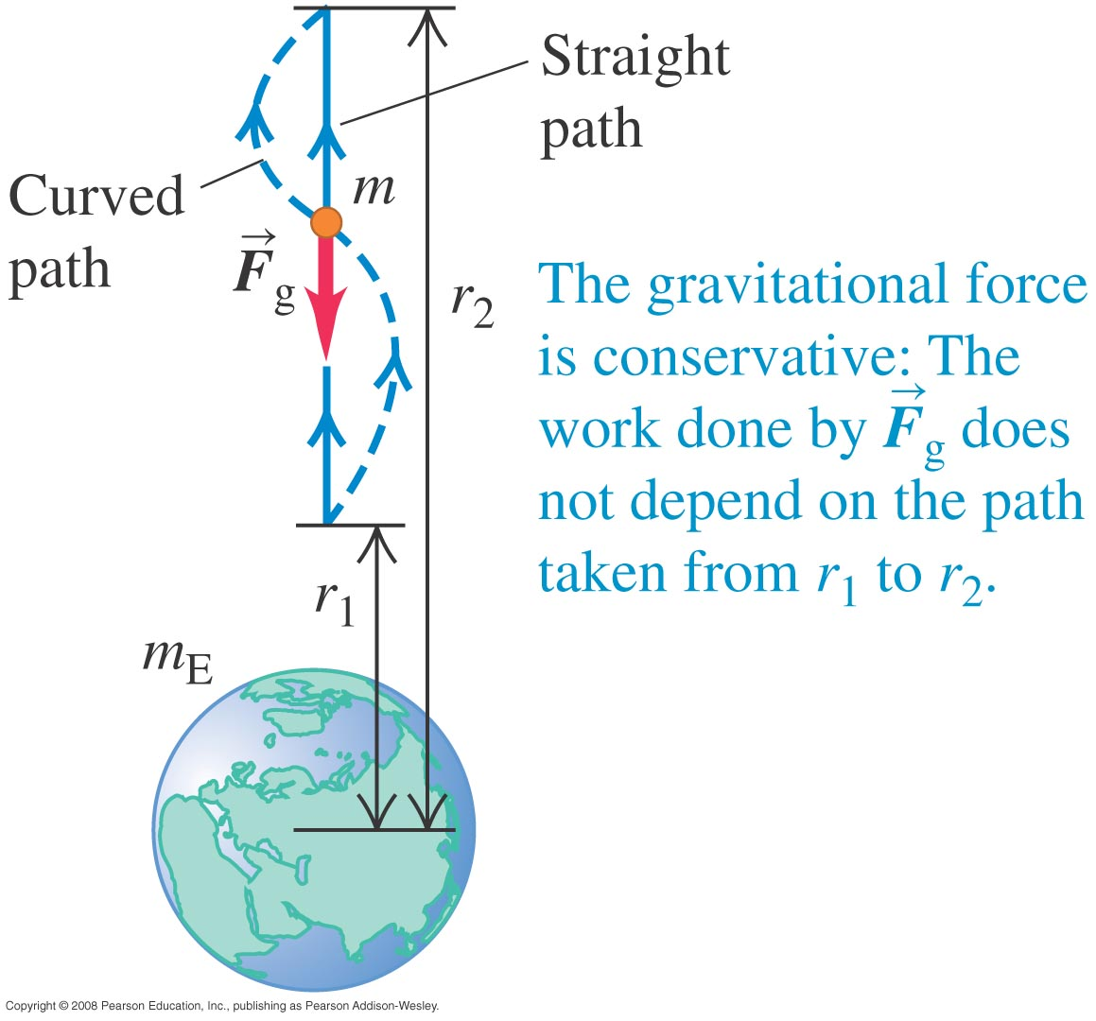
Gravitational potential energy
The gravitational potential energy of a system consisting of a particle of mass m and the earth is U = –Gm_{E}m/r.

Slide 12
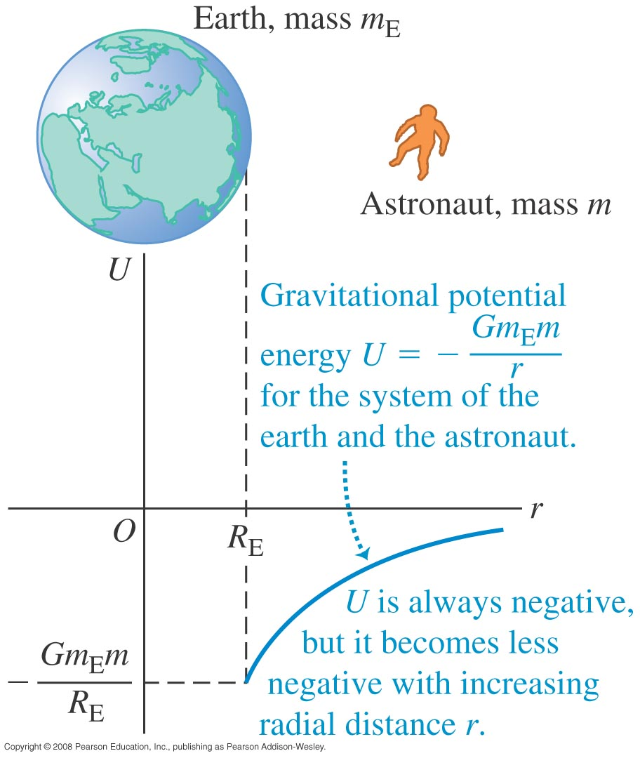
Gravitational potential energy depends on distance
The gravitational potential energy of the earth-astronaut system increases (becomes less negative) as the astronaut moves away from the earth.

Slide 13
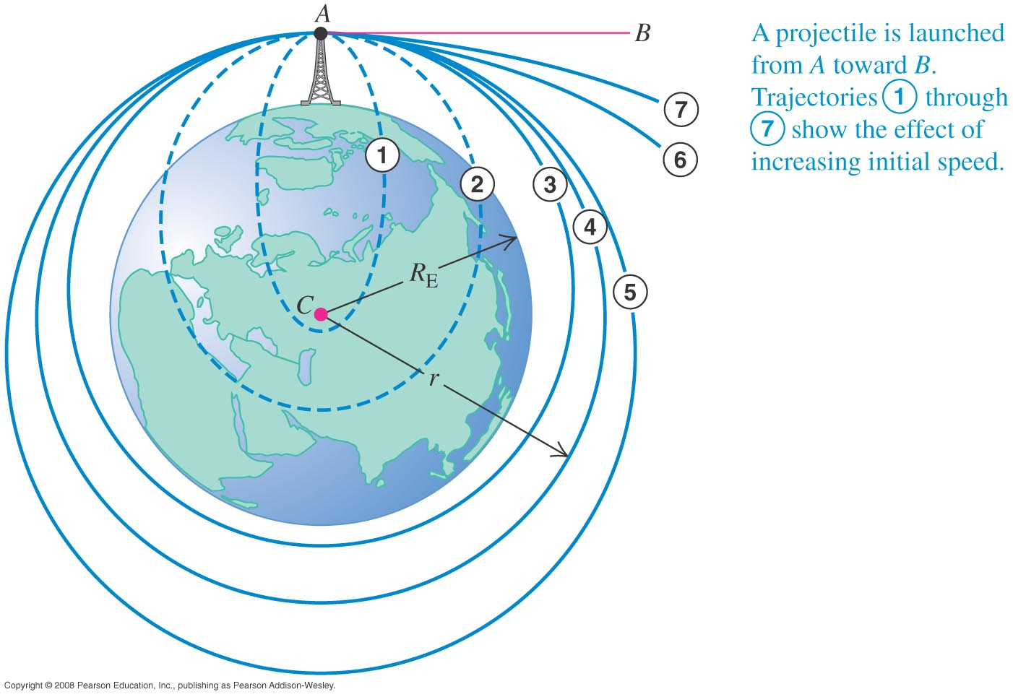
The motion of satellites
The trajectory of a projectile fired from A toward B depends on its initial speed. If it is fired fast enough, it goes into a closed elliptical orbit (trajectories 3, 4, and 5).

Slide 14
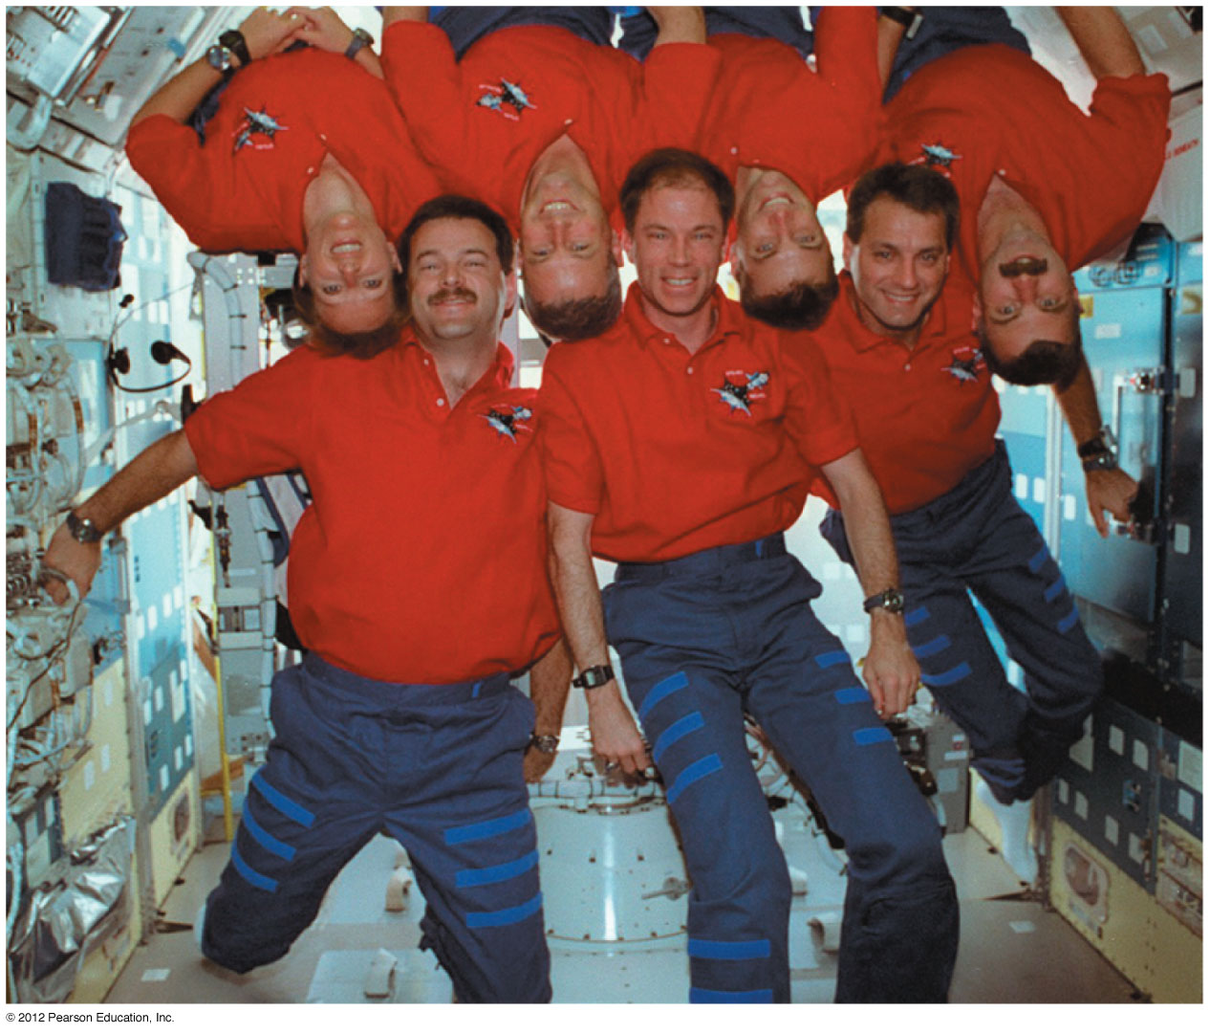
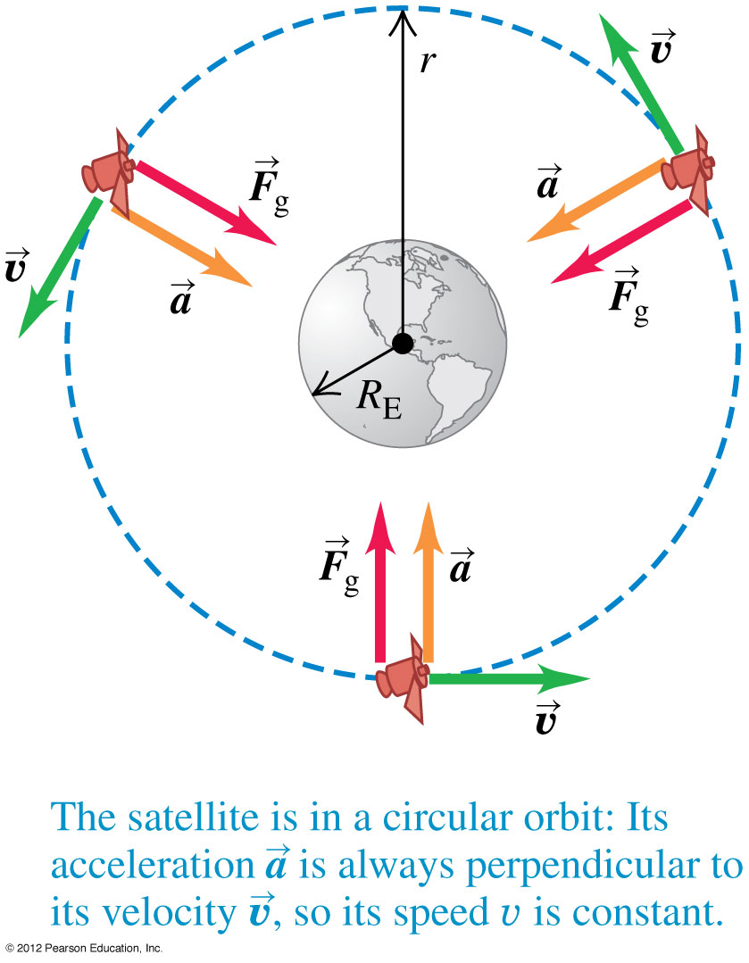
Circular satellite orbits
For a circular orbit, the speed of a satellite is just right to keep its distance from the center of the earth constant.
A satellite is constantly falling around the earth. Astronauts inside the satellite in orbit are in a state of apparent weightlessness because they are falling with the satellite.

Slide 15
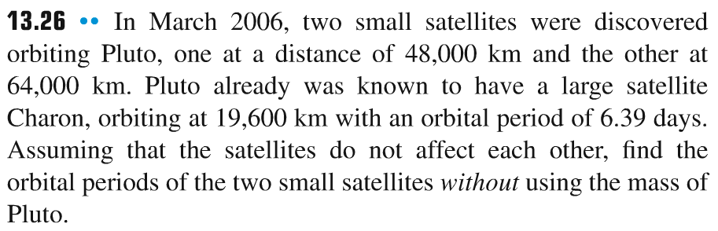
Problem #4

Slide 16
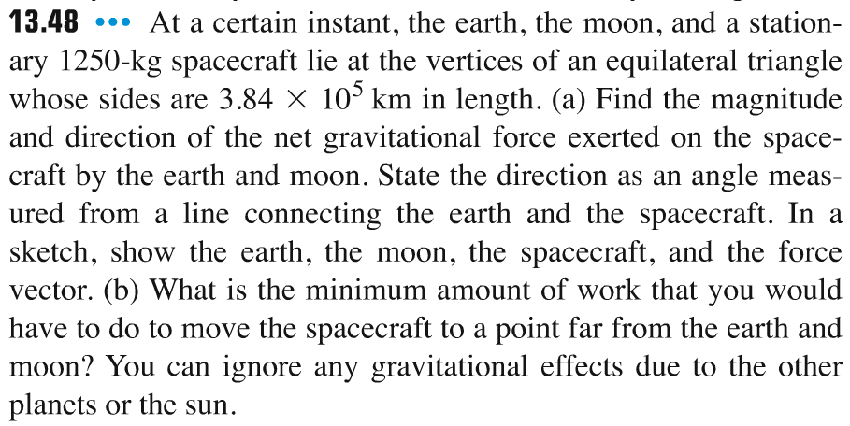
Problem #5

